Slide 1

Microsoft 365 platform community call
aka.ms/m365pnp
Your host in this call: Brian T. Jackett
May 10, 2022

Slide 2
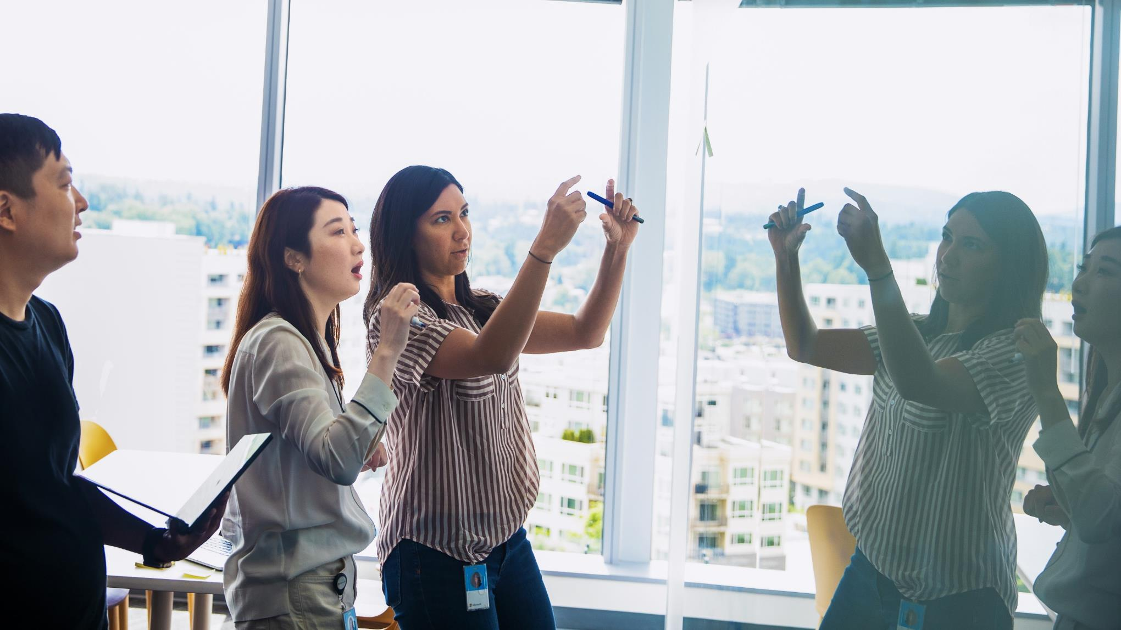
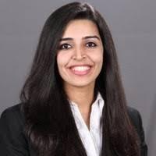

Agenda
Latest updates and news on the Microsoft 365 platform
Monthly summary on Microsoft 365 Platform community contributors
Group picture time with Together Mode!
Demos
Namrata Khubchandani - Extend your Teams Search Based Message Extension to Outlook
David Rousset - Getting started on using Azure Communication Services in your web site

Slide 3
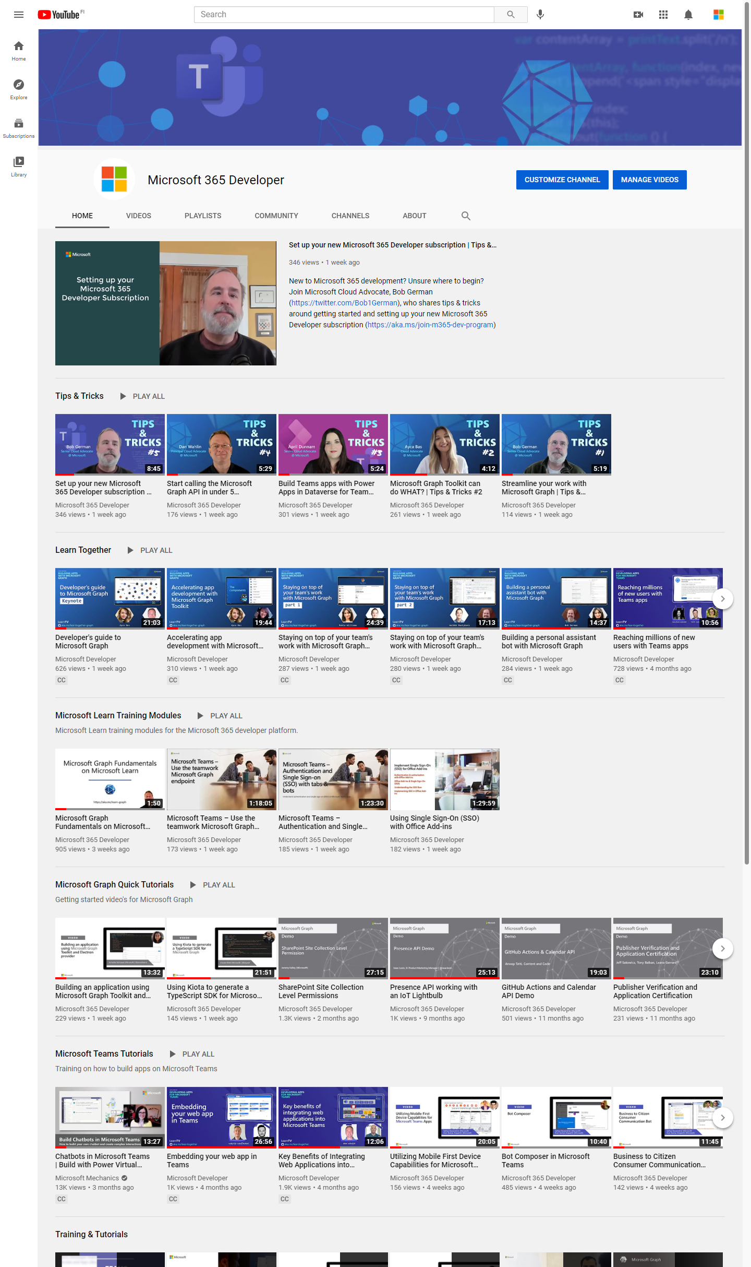
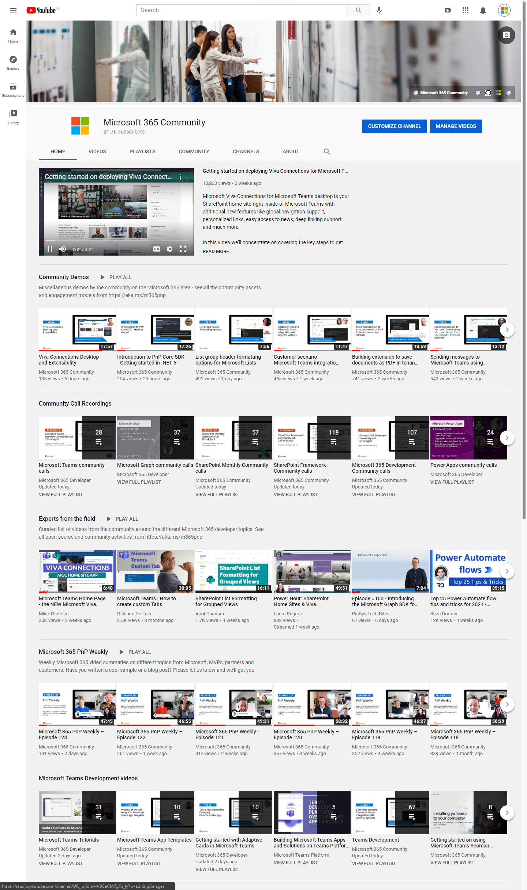
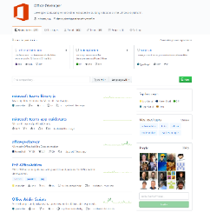
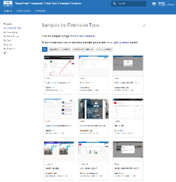
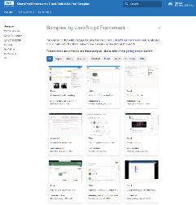
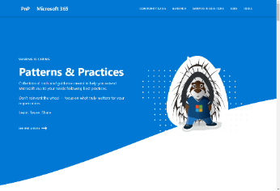
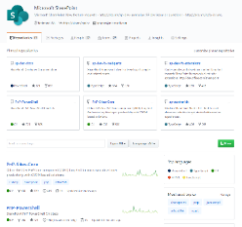
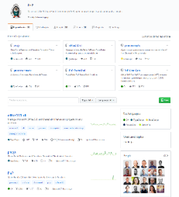
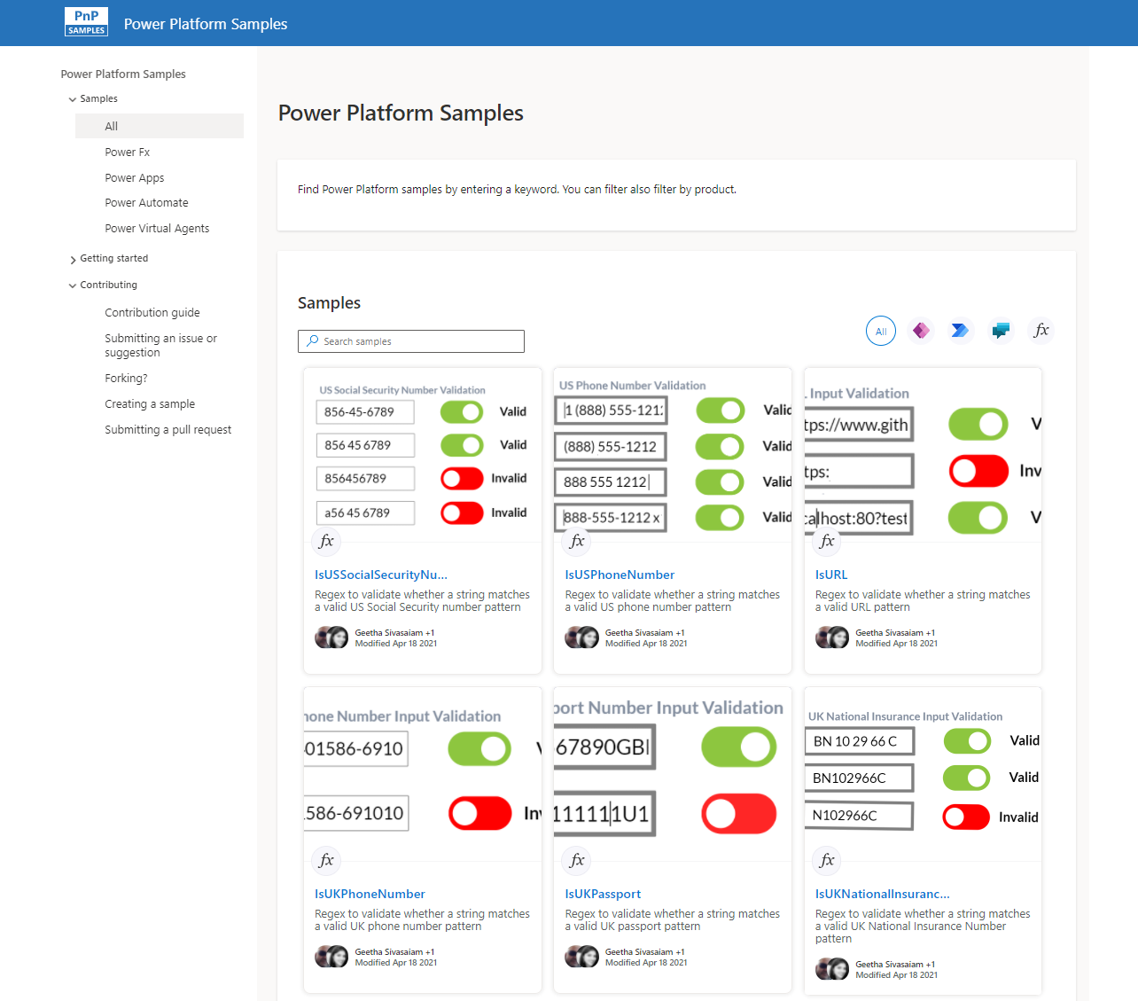
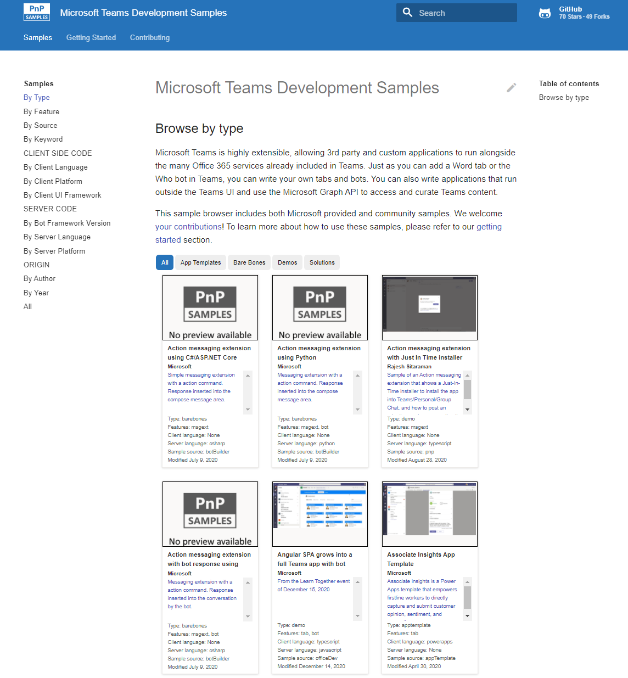
Microsoft 365 developer videos
Microsoft 365 community videos
Open-source
Sample galleries
Open-source initiatives and samples
aka.ms/m365devyoutube
aka.ms/m365/videos
github.com/pnp
github.com/officedev
github.com/sharepoint
github.com/microsoftgraph
aka.ms/m365/samples
aka.ms/teams-samples
aka.ms/spfx-webparts
aka.ms/powerplatform-samples
aka.ms/spfx-extensions
aka.ms/list-formatting
aka.ms/m365pnp
@Microsoft365Dev | @m365pnp

Slide 4
Microsoft 365 developer community calls
Microsoft 365 platform (weekly) https://aka.ms/m365-dev-call
(Notice. This call is on a summer break between July 1st and 31st of August 2022)
Adaptive Cards https://aka.ms/adaptivecardscommunitycall
Microsoft identity platform https://aka.ms/IDDevCommunityCalendar
Office Add-ins https://aka.ms/officeaddinscommunitycall
PowerApps https://aka.ms/PowerAppsMonthlyCall
Microsoft 365 community (bi-weekly) https://aka.ms/m365-dev-sig
Viva Connections & SharePoint Framework (bi-weekly) https://aka.ms/spdev-spfx-call
Download recurrent invites from
https://aka.ms/m365/calls
Notes:
m365-dev-sig

Slide 5

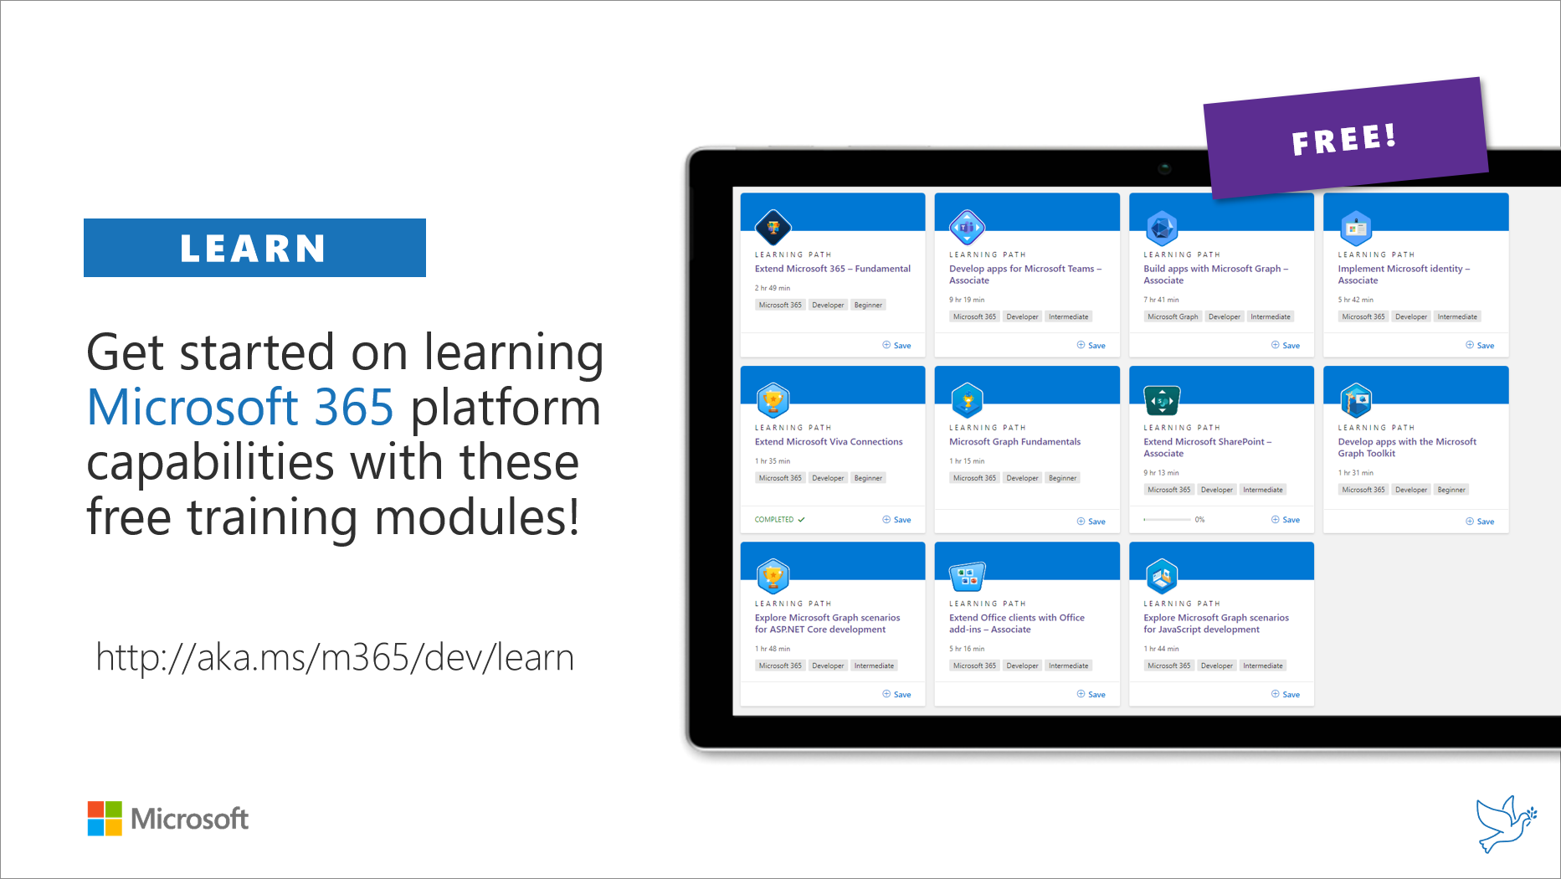
Getting started assets for Microsoft 365 dev
aka.ms/m365/devprogram
aka.ms/m365/dev/learn

Slide 6

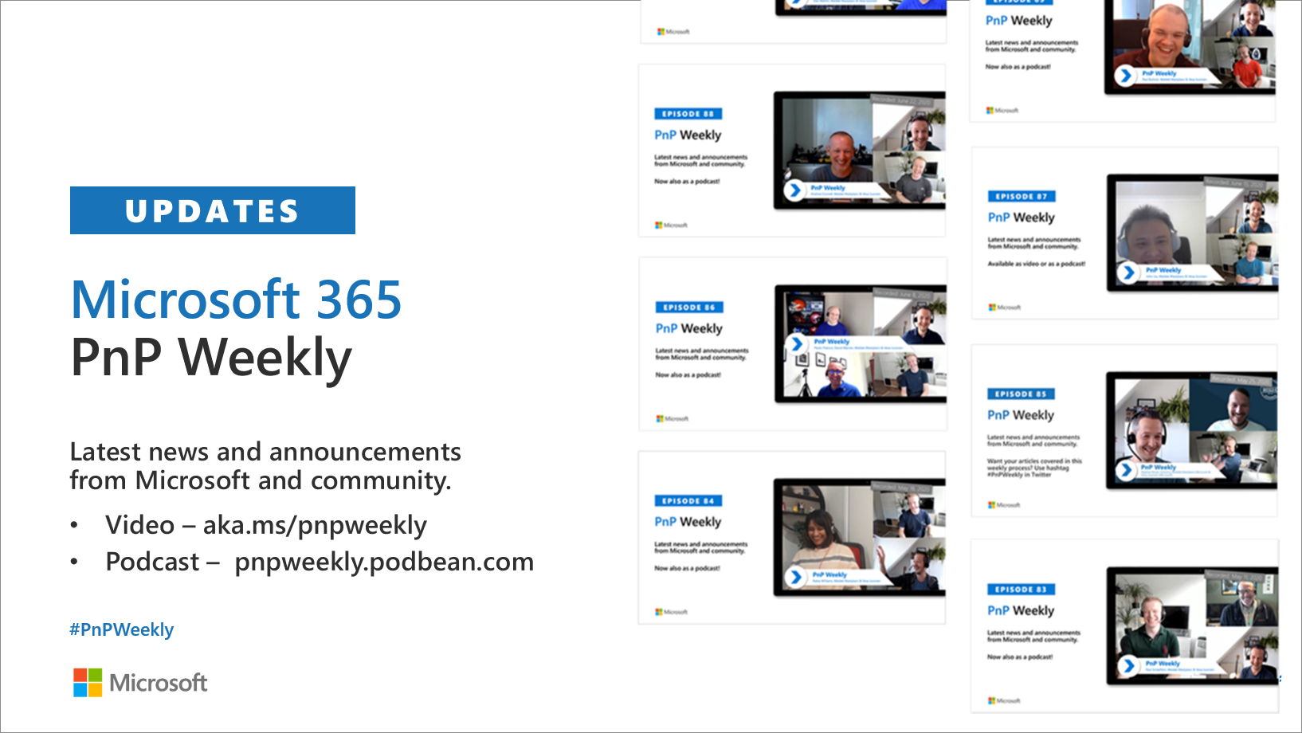
Microsoft 365 Developer podcasts
m365devpodcast.com
Video – aka.ms/pnpweekly
Podcast – pnpweekly.podbean.com

Slide 7

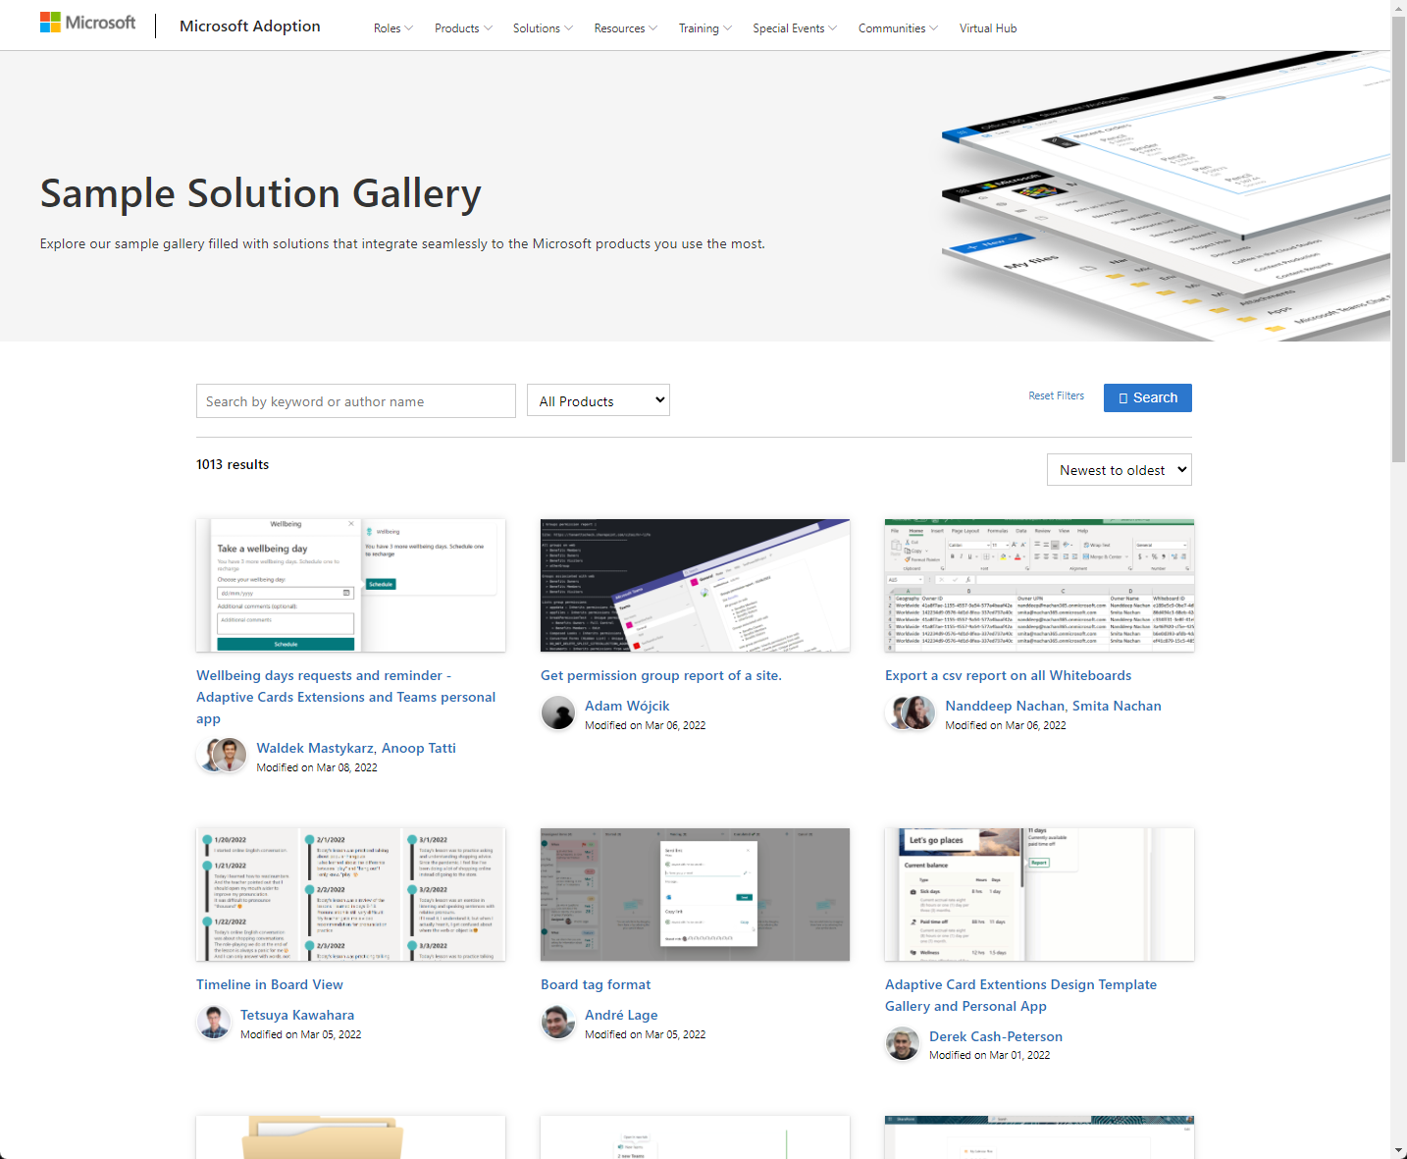
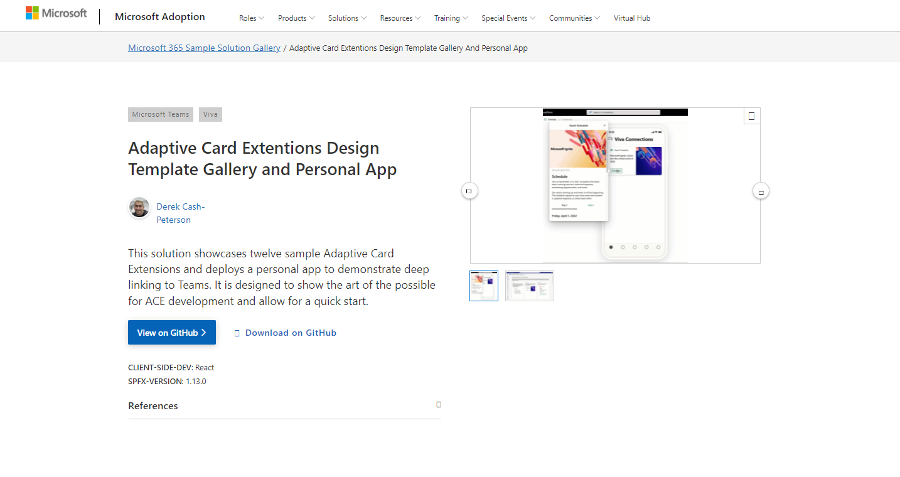
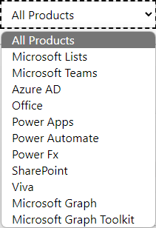

SAMPLES
New Microsoft 365 sample gallery with more than 500 samples from Microsoft and community
1065
aka.ms/m365/samples

Slide 8

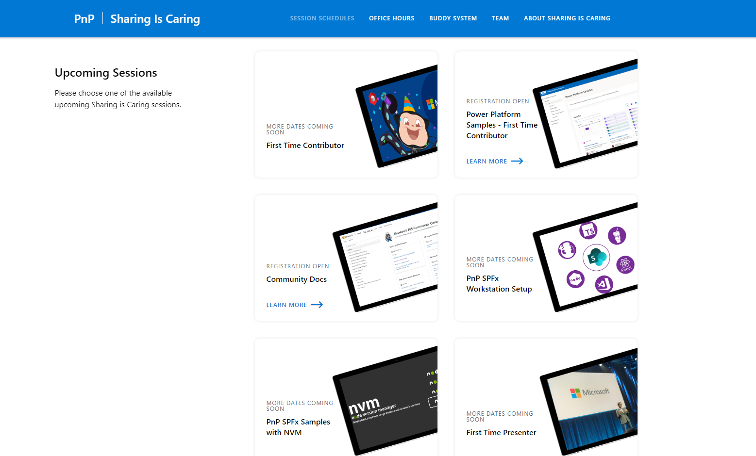
GUIDANCE
Learn how to get started in the open-source PnP community!
Upcoming Sessions:
General First Time Contributor
Power Platform Samples – First Time Contributor
SPFx Developer Workstation Setup
Using PnP SPFx samples w/ NVM
More than code with VS Code
First-time presenter
M365 Maturity Model Practitioners
Community Content Docs
NEXT WEEK
https://aka.ms/sharing-is-caring
Notes:
25 Total attendees, 16 attendees who attended both First-Time Contributors and Community Docs sessions.

Slide 9

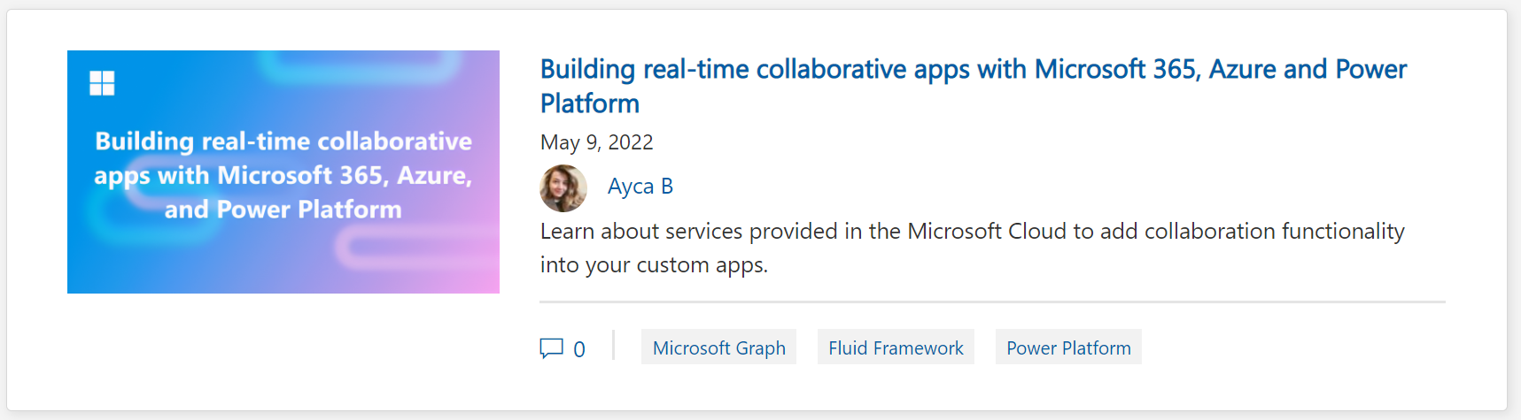
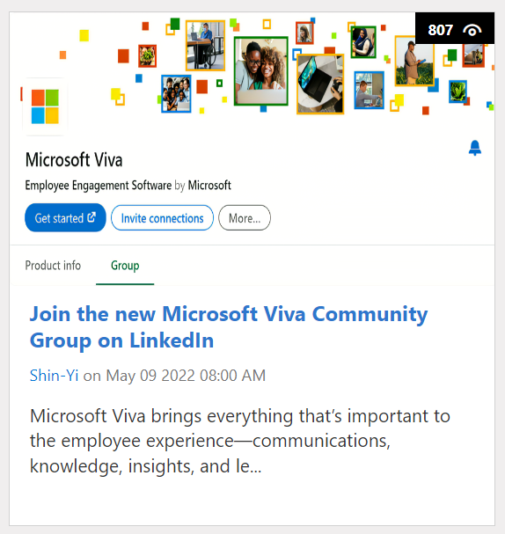
https://aka.ms/m365dev/blog
https://aka.ms/teams/blog
https://aka.ms/microsoftviva/blog
Notes:
New pull as needed sync model for content types along with APIs
Recap news and announcements from Enterprise Connect including Teams Rooms, RSVP options for hybrid meetings, and more
Follow up to initial customer story with Atlassian to dive deeper into Teams app
Tips and tricks for using Power Automate to track and collaborate on tasks

Slide 10
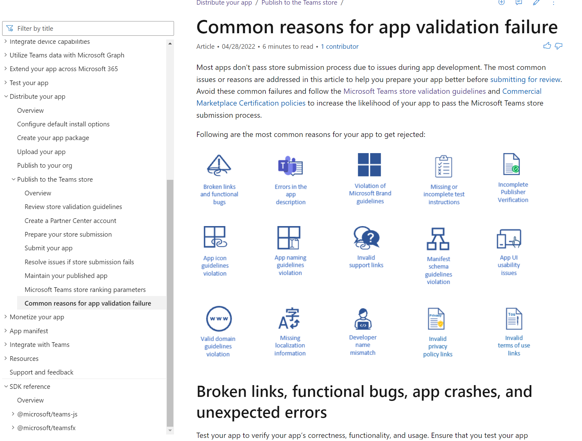
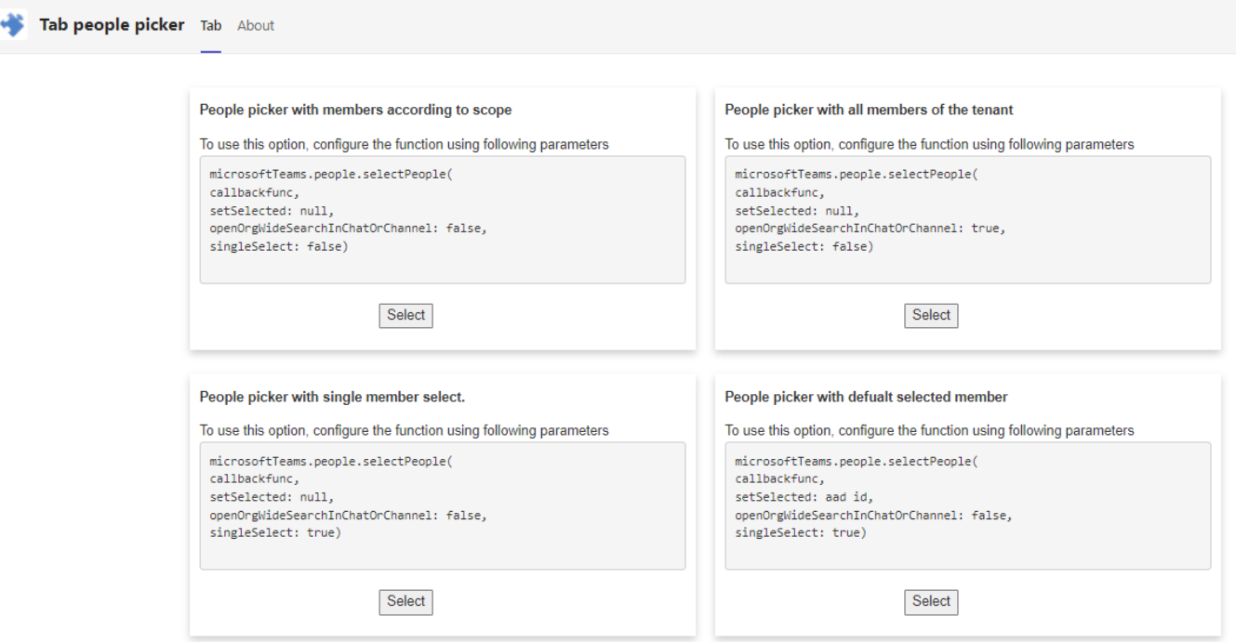
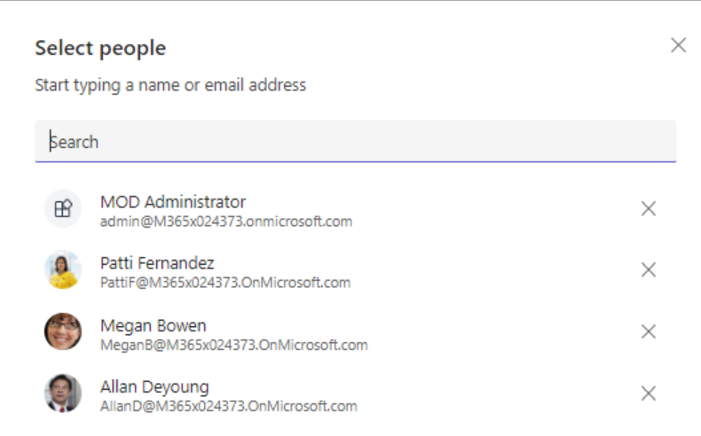






Teams Platform updates Sample code
Doc updates Clickable icons
1
Sample code for People picker in Tabs
2
Docs: http://aka.ms/TeamsDevDocs > Distribute your app > Publish to the Teams Store > Common reasons for app validation failure
Repo: aka.ms/TeamsSamples > samples > tab-people-picker
@Microsoft365Dev
aka.ms/TeamsPlatformUpdates
aka.ms/TeamsDevDocs
aka.ms/TeamsSamples
aka.ms/TeamsPlatformFeedback
Notes:
Surbhi Gupta covering 5/10/2022 Hello everyone. I’d walk you through the platform and documentation updates. Let’s start with the platform update on the left side.
We’ve published new sample which showcase how to use people picker using Microsoft Teams client SDK. This uses microsoftTeams.people.selectPeople()method which allows selecting people from specific context like group chat, team, and tenant.
You can find the repo link here.
Now let’s move to the doc updates on the right
2. We’ve included clickable icons in our docs to enhance visual experience. This would give you a snapshot of what we offer in an article without having to scroll through the entire doc, and you’d be able to get the information at a click of a button.
So, these were the platform updates, if you have any feedback or suggestion, please post on aka.ms/TeamsPlatformFeedback- the link is available in the footer. You could also follow us on twitter and configure to the RSS feeds to get regular platform updates.

Slide 11

EVENT
Microsoft Build
May 24-26
Registration now open:
https://mybuild.microsoft.com

Slide 12



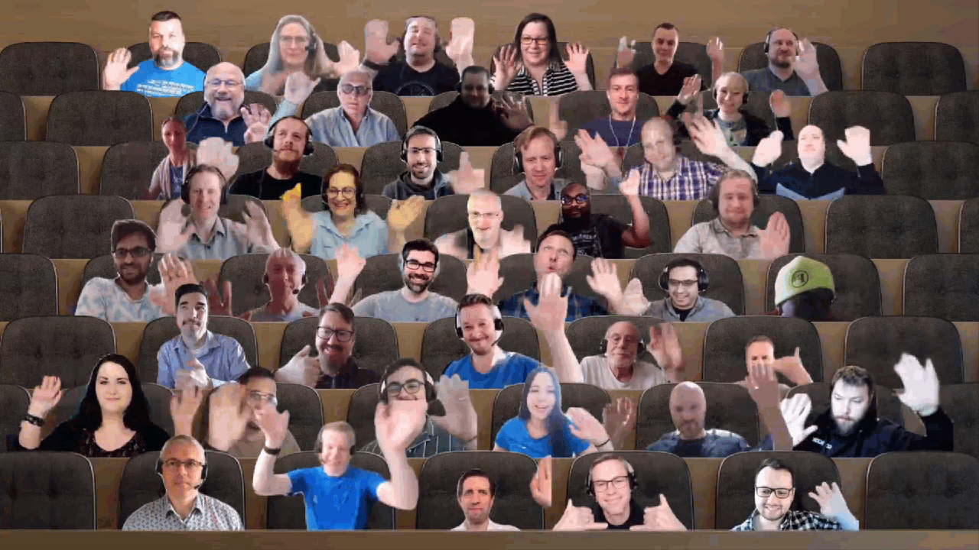


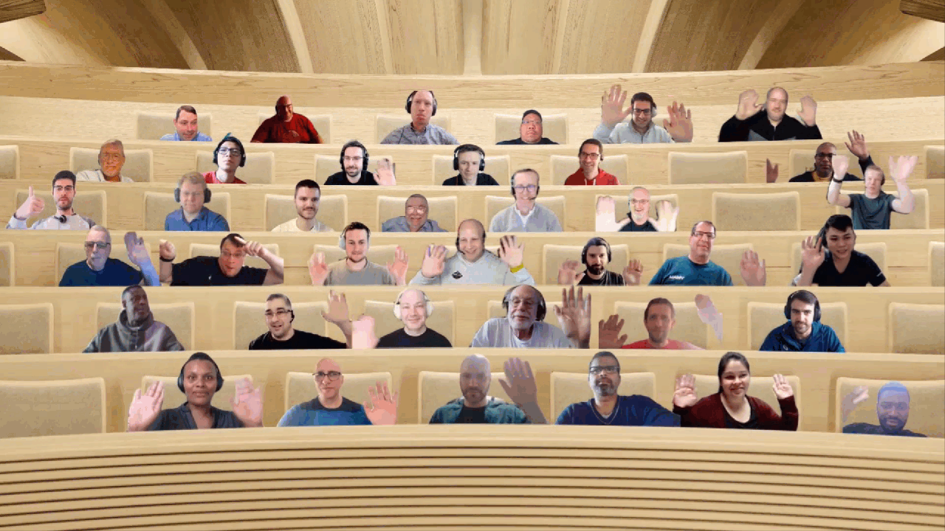




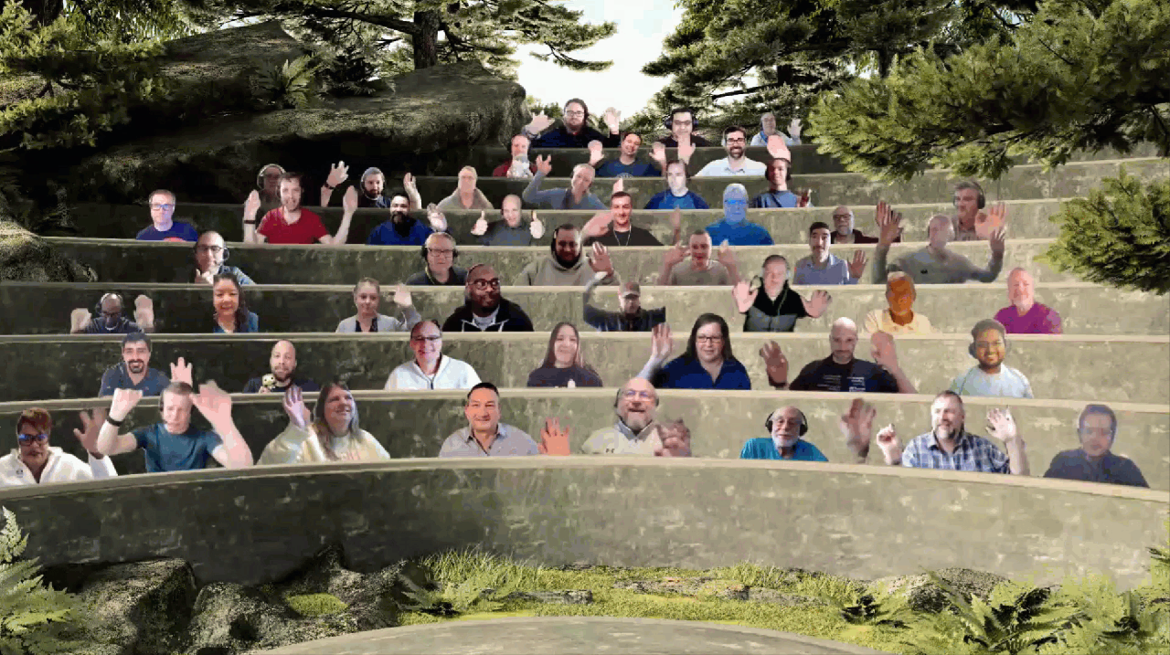







UPDATE
Microsoft 365 Platform Community (PnP) – May 2022 update is available! Thank you for your contributions!
http://aka.ms/m365pnp/community/blog

Slide 13

Thank you for your assistance within last month! (A-D)
Abderahman Moujahid (iThink365) | Abderahman88
Adam Wójcik (Hitachi Energy) | @Adam2585878
Ademosu Ayodele | aaademosu
Aimery Thomas | @aimery_thomas
Albert-Jan Schot (BLIS Digital) | @Appieschot
Alex Gonsales (Intergen) | MrDrSushi
Alexander Ernon (Amplexor)
Aleksandr Sapozhkov | shurick81
Alexis CONIA (Kickle) | @Alexis_conia
Alienson | @Alienson
Alistair Pugin (Tangent Solutions) | @Alistairpugin
Akash Karda | @akkikarda
André Lage (Datalynx AG) | @aaclage
Andreas Omayrat | andreasomayrat
Andrea Mondello (Withum Smith + Brown) | @Mondello_power
Andrew Burns (AmSty) | @SharePointRox
Andrew Connell (Voitanos) | @Andrewconnell
Andrew Pilcher (CSULB) | andrewpilcher
Andy Harmon (Oldham Metropolitan Borough Council) | @Andygharmon
Anjaneyulu Yarlagadda | yarlagaddaanji
Annie Torres (Coppin State University)
Anoop Tatti (Content+Cloud) | @Anooptells
Antti Pajunen (Forward Forever) | @Anttipajunen
Aric Bost (North Carolina Housing Finance Agency) | @1CyberState
Arjan Cornelissen | @arjancornelis
Arjun Menon (Tata Consulting Services) | @Arjunumenon
Arleta Wanat | PowershellScripts
Art Pagano (University of Texas San Antonio)
Artur Posluszny | aposl1
Asad Refai (Intelogy) | @AsadRefai
Ashwani Kumar (Walmart Global Tech) | @Ashwanidv100
Bartolomeo Sorrentino (soulsoftware) | @BsorrentinoJ
Beau Cameron (Aerie Consulting) | @Beau__Cameron
Bianca W | bianca-git
Bob Morris (ThreeWill)
Brian McCullough | @bpmccullough
Carianne Wong (Majesco) | @CW_marie
Carike Blignaut-Staden | @CarikeBStaden
Carl Joakim Damsleth | @kimzter
Catherine Thenault (AIPSO) | @O365techcat
Chanaka Palliyaguru (Fortude) | @Chanakavp
Chandani Prajapati (Rapid Circle) | @Chandani_SPD
Chandra Sekhar Malla (Royal Group LLC) | @ChandraSMall
Chris Kent (DMI) | @TheChrisKent
Chris Sparrow (PA Consulting)
Christian Zuellig (MondayCoffee) | czullu
Christophe Humbert | @Path2SharePoint
Christopher Graves (Arvato) | @Christo48927551
Chuck Piotrowski (PIOT) | @chuckpiot
Clavin Fernandes (Rapid Circle) | @Clavinfernandes
Clement Olivier | @Clement0livier
Cynthia Tiwana (city of sammamish) | ctiwana
Damien Bird | @DamoBird365
Daniel Laskewitz (Sogeti) | @Laskewitz
Daniel Westerdale (Westerdale Solutions Ltd) | @Westerdaled
Danish Shafi | @Builtbydan
Darren Brown (Node4)
Dave Young | @Klarkykhat
David Gray (Visa)
David Pileggi (Staples) | DavidPileggi
David Ramalho | @DRamalho92
Dean Gross (Insight) | @Dean144
Dennis Goedegebuure (Ultima Business Solutions) | Expiscornovus
Derek Cash Peterson (Sympraxis Consulting) | @Spdcp
Dennis van Niel | dennisvanniel
Dipen Shah (Rapid Circle) | @Dips_365
Don Kirkham (DMI, Inc) | @DonKirkham
Dr Adrian Colquhoun (Strategik) | iddycol
Notes:
SHARING KNOWLEDGE IS MULTIPLYING KNOWLEDGE

Slide 14
Thank you for your assistance within last month! (E-K)
Edmund David (Insentra)
Edris Kakembo (WFP) | @Kaxeddie
Eduardo Cáceres | eduherminio
Ejaz Hussain (Content and Cloud) | @EjazHussain"
Elio Struyf (Struyf Consulting) | @Eliostruyf
Elise Yang (Shopify) | elisenyang
Elka Dunnette | @ElkaD_YYC
Emily Mancini (Sympraxis Consulting) | @EEMancini
Eric Overfield (PixelMill) | @EricOverfield
Erwin van Hunen (Valo Intranet) | @Erwinvanhunen
Florian Zink | fzbm
Franck Cornu | @FranckCornu
Ganesh R (RapidCircle) | @Geekwhocodes
Ganesh Sanap (Globant) | @GaneshSanap20
Garrick George (City of Thornton) | @Kod3m0ng3r
Gaurav Mahajan | @Mahajang
Gautam Sheth (Valo Solutions) | @Gautamdsheth
Geert de Kooter | @gdekooter
Geetha Sivasailam (Artis Consulting) | @GSiVed
Giacomo Pozzoni (Fellowmind) | jackpoz
Giuliano De Luca | @delucagiulian
Greg Hitchon | Greg-Hitchon
Haritha Sama (Intouch Solutions)
Harry Jones (Civica) | @Hejones50
Harsh S (SRK Consulting)
Harsh Samdani | hsamdani12
Harshini Varma (Capgemini) | @HarshiniVarmaa
HEMANT RISBUD (SRK Consultants) | Hemant Risbud
Henrik Yllemo (Ylltec Sweden AB) | @Yllemo
Inez Jacobs (Amplexor)
Isolde Kanikani (SoftwareONE)
Jacob Warrington (Catapult Systems) | @Jjhwarrington
Jake Stanger | JakeStanger
James May | fowl2
Jan Bakker | @JanBacker_
Jasey Waegebaert (MI group) | Jwaegebaert
Javier Hualpa | jhualpa
Jeffin Jacob | jeffinjacob
Jennifer Davison (Akron Children’s Hospital)
Jennifer Erzen (SUNY Upstate Medical University) | @Jennifererzen
Jennifer McGee | RainWatcher
Jerker Vallbo | jerval53
Jhan Zaib (Ascertia) | jhan-zaib
Jim Duncan (ShareSquared) | @Sparchitect
Jinlong Wang | apzl808
Jiten Parmar (Rapid Circle) | @Jitenpa44241205
João Ferreira | @Joaoferreira
João J. Mendes (Valo Solutions) | @Joaojmendes
Joel Rodrigues (Storm Technology) | @JoelFMRodrigues
Jonas Björkander (Heimstaden) | @Jonasbjor
Jonathan Hinchliffe (Imperial War Museums)
Jonathan Weaver (WaterOne) | @J_weaver74
Jono Duncan (JourneyTEAM) | @SuaveJono
Julie Turner (Sympraxis Consulting) | @Jfj1997
Kasper Bo Larsen (Fellowmind) | @Kasperbolarsen
Kathleen Boilek (Alaka’ina Foundation) | @Kaboilek
Katleen Van Trier (Inetum-Realdolmen) | @Kvantrier
Katrin Rannaste
Kevin McDonnell (CPS) | @Kevmcdonk
Kim Kiefer (GenTech Associates) | @Kkkiefe
Krishna Rachakonda (Catapult) | rsk2013
Kunj Balkrishna Sangani | @Sanganikunj
Kyle Bigelow | hazondata
Notes:
SHARING KNOWLEDGE IS MULTIPLYING KNOWLEDGE

Slide 15
Thank you for your assistance within last month! (L-P)
Lance Yoder (Cerner) | @Lyoder
Laura Kokkarinen (Sulava) | @LauraKokkarinen
Laurent Egbakou | @Lioncoding
Lee Ford ( Symity) | @Lee_Ford
Leon Armston (Intelogy) | @LeonArmston
Lindsay Shelton (Stowers Institute for Medical Research) | @Lshelton_tech
Loïc Cimon (Sogeti) | @LoicCimon
Luise Freese (M365Princess) | @LuiseFreese
Manickam Sethuramalingam (microland)
Manjunath Puttaswamy (Momentive Performance Materials India Private Limited) | @ManjunathPutta3
Marc Anderson (Sympraxis Consulting) | @Sympmarc
Markus Joschko | jocsch
Markus Möller (Avanade) | @Moeller2_0
Martin Lingstuyl | @Martinlingstuy
Matt Beard (Data8) | @Mattybeard
Mathijs Verbeeck | MathijsVerbeeck
Matt Collins-Jones | @D365Geek
Michael Blumenthal (M365chicago.com) | @MichaelBL
Michaël Maillot ( OnePoint) | @michael_maillot
Michael Roth ( ITP) | @MichaelRoth42
Michal Guzowski (Developico) | @Abcguzowski
Michal Romiszewski | @Romiszewski
Michal Ziemba (Flugger) | @Michal_Ziemba
Michel Mendes | @Michelcarlo
Michelle Heisler (Hennepin County)
Miguel Angel García | @Miangama
Milan Holemans | milanholemans
Mike Duffy (Boardwalk Pipelines) | @Mike_duffy
Mike Dumka (Habanero Consulting) | @Mikedumka
Mike Homol (ThreeWill) | @homol
Mike Zimm | mikezimm
Mohammad Amer (Atea Global Services) | @Mohammad3mer
Nader Hadjebi | @nader2015
Nanddeep Nachan | @nanddeepNachan
Nathan Zipf | NathZ1
Naveen Karla | @naveen67
Nicole Fleming (Sherwin Williams)
Nikki Chapple (Cloudway) | @Chapplenikki
Nizar Grindi (Avanade) | @nizar_grindi
Norm Young (UnlimitedViz) | @Stormin_30
Omar Stewart | @OmarStewey
Paolo Pialorsi (PiaSys.com) | @PaoloPia
Patrick de Lanoy(EmpowerTech) | @EmpowerPatrick
Patrick Doran (NCDIT) | @Swearpointjs
Patrick Galloway | BammaSlim
Patrick Lamber (ExpertsInside AG) | @Patricklamber
Patrik Hellgren (Sherpas Group) | @Patrikhellgren
Paul Bullock (Avanade) | @Pkbullock
Paul Culmsee (Seven Sigma) | @Paulculmsee
Paul McManus | @PaulMcManus23
Paul Schaeflein (AddIn365) | @Paulschaeflein
Pedro Monte (BindTuning) | PedroMordeP
Pete Simpkins (Fluid Interiors) | @Simpkinspete
Pete Skelly (ThreeWill) | @Pskelly
Phil McNiven | phil0074
Pierre Geraud (Bluekango) | pedrion
Prafull Kotecha | @Prafull
Notes:
SHARING KNOWLEDGE IS MULTIPLYING KNOWLEDGE

Slide 16
Thank you for your assistance within last month! (R-Z)
Ralph Rivas (Sogeti) | @Bigpix2000
Rentu | SLdragon
Reshmee Auckloo (Pension Protection Fund) | @ReshmeeAuckloo
Rico van de Ven | RicoNL
Rick Van Rousselt (Advantive) | @RickVanRousselt
r-markus | r-markus
Rob Bell (Kizan technologies)
Rob Ellis | ee61re
Rob Ireland (Oast House Ltd) | @RobIreland68
Robert Copelan (ZF Friedrichshafen AG) | @Rcopelan
Robert Dyjas (EQTek) | @Robdy
Robert Lindström | robert-lindstrom
Robin Rosengrün (EnBW) | @power_r2
Rodrigo Pinto (Storm Technology) | @ScoutmanPt
Rohit S Patil (C3it)
Russell Gove (tronox) | @Russgove
Ruth Shyer (SuMMit Consulting, LLC) | @Rshyer
Ryan Healy (365Apps) | @Ryan365Apps
Sabrina Faragoza (Cognizant’s Microsoft Business Group)
Sachchin Annam (Freelancer) | @Sachchinn
Sam Bridegroom (Allied Solutions) | @Sambridegroom
Sami Nieminen | stniemin
Sebastian Zolg (Swisscom) | @sebastianzolg
Sekar Thangavel (IBM) | SekarThangavel
Sergei Sergeev | @Sergeev_srg
Sharon Weaver (Smarter Consulting) | @Sharoneweaver
Shishir | skky05
Shrushti Shah (Rapid Circle)
Siddharth Vaghasia | @Siddh_me
Simon Ågren | @AgrenPoint
Simon Doy (iThink 365) | @Simondoy
Simon Hudson (Novia Works) | @Simonjhudson
Smita Nachan | @SmitaNachan
Someleze Diko | DikoSomeleze
Sorina Becheru (abtis GmbH)
Soumit Mukherjee | @Msoumit
Soumyadeep Mukherjee | soumyadeep2207
Sourav Paul | @Spsouravp
Stefan Bauer (n8d) | @StfBauer
Stephan Bisser (Solvion) | @Stephanbisser
Stephen Peters | StephenBrentPeters
Steven Reid (FTZ) | @Steven_reid
Sujith Pasupuleti (NRF) | @Sujith1907
Sumit Jadon (Avanade) | @CoolJadon
Sunish (SACHA Solutions) | @Sunish
Takashi Shinohara | @Karamem0
Tammy Dupuy (CSULB)
Tetsuya Kawahara | @Techan_k
Thomas Gölles (Solvion) | @Thomyg
Tim Balk (Wellmark) | @Tlbalk
Tim Cadenbach (Maximago) | @TimCadenbach
Timo Pertilä (Forward Forever) | @timopertila
Tod Beane
Todd Alexander (Island Way Technology)
Todd Baginski (Canviz) | @Toddbaginski
Tom Morgan (Modality Systems) | @tomorgan
Tomasz Poszytek | @TomaszPoszytek
Tony Derricott (BYUI) | @Computx
Troy Taylor (Hitachi Solutions) | @Troystaylor
Twan van Beers (Nero Blanco) | @neroBlancoIT
Vardhaman Deshpande (Valo Solutions) | @vrdmn
Veronique Lengelle (CPS) | @Veronicageek
Victor Ezeliorah (Intels Nigeria Limited) | @Vezeliora
Vijay Sisodia(Accenture) | @ec0321
Vipul Kelkar (Rapid Circle) | @Vipulkelkar
Vivek Bavishi | @That_API_guy
wuxiaojun514 | wuxiaojun514
Yannick Plenevaux (PVX Solutions) | @Yp_code
Youssef Moumen
Yves Habersaat (Sword Group) | @Yhabersaat
Zach Roberts | @ZachSPODev
Notes:
SHARING KNOWLEDGE IS MULTIPLYING KNOWLEDGE

Slide 17





























Companies involved with May 2022 summary
Companies which provided support for community
We can only show the company logos which we have explicitly approval for logo usage
You contributed and your company is not here? – Send us a message with your permissions and logo
Notes:
SHARING KNOWLEDGE IS MULTIPLYING KNOWLEDGE

Slide 18

Thank you for your assistance! – Microsoft
Aakash Bhardwaj (Microsoft) | @Aakash_316
Abid Rahman (Microsoft)
Alex Clark (Microsoft) | @Sharepointalex
Alex Terentiev (Microsoft) | @Alexaterentiev
Aline Tognini (Microsoft) | alinefmr
Allen Snow (Microsoft) | @Asnow003
Altamish Ahmad (Microsoft)
Andrey Esipov (Microsoft)
Anuj Gupta (Microsoft)
April Dunnam (Microsoft) | @Aprildunnam
Arijit Mondal (Microsoft)
Arvind Ravi (Microsoft)
Ashima Mathur (Microsoft)
Ayca Bas (Microsoft) | @Aycabs
Bert Jansen (Microsoft) | @O365Bert
Beverly Kim (Microsoft) | bvandaal
Bob German (Microsoft) | @Bob1German
Brian Dang (Microsoft) | @Mrdang
Brian Jackett (Microsoft) | BrianTJackett
Bryan Petersen (Microsoft) | bpeterse03
Camille Birch (Microsoft)
Cathy Dew (Microsoft) | @Catpaint
Charles Sterling (Microsoft) | @Chass
Christer Ljung (Microsoft)
Christos Matskas (Microsoft) | @ChristosMatska
Dan Wahlin (Microsoft) | @DanWahlin
Dave Randall (Microsoft) | triplanedave
David Chesnut (Microsoft) | @Davidchesnut
David Warner II (Microsoft) | @DavidWarnerII
Didun Ayodeji (Microsoft)
Doğan Erişen (Microsoft) | derisen
Dragan Panjkov (Microsoft) | @Panjkov
Ed Averett (Microsoft) | Ed_Everett
Emily Lynam (Microsoft)
Eoin O’Brien
Elizabeth Samuel (Microsoft)
Emma Cooper (Microsoft)
Garry Trinder (Microsoft) | @Garrytrinder
Haimantika Mitra (Microsoft) | @HaimantikaM>
Holger Lutz (Microsoft) | HolgerLutz
Hugo Bernier (Microsoft) | @Bernierh
Igor Ribeiro (Microsoft)
James Eccles (Microsoft) jameseccles
James Skay (Microsoft) | @JamesSka
Japhlet Nwamu (Microsoft) | @Japhletnwamu
Jasey Waegebaert (Microsoft) | Jwaegebaert
Jasmine Hoegh (Microsoft) | @Sbjishu
Jason Johnston (Microsoft) | jasonjoh
Jay Hangan (Microsoft)
Joanne Hendrickson (Microsoft) | JoanneHendrickson
John Nguyen (Microsoft) | johnguy0
John Sudds (Microsoft) | @Jsuddsjr
Join Sahil Baid (Microsoft)
Jos Verlinde (Microsoft) Josverl
Jyoti Pal (Microsoft)
Kavishi Agarwal (Microsoft)
Kevin Coughlin (Microsoft) | @Kevintcoughlin
Keyur Patelsdata (Microsoft)
Koen Zomers (Microsoft) | @Koenzomers
Holland Kaviani (Microsoft)
Laura Graham (Microsoft) | Lauragra
Holland Kaviani (Microsoft)
Lee Stott (Microsoft) | @Lee_Stott
Linda Delarvé (Microsoft)
Linda Lu Cannon - (Microsoft) | lindalu-MSFT
Loki Meyburg (Microsoft) (Microsoft) | @Lokimeyburg
Luca Bandinelli (Microsoft) | lucaband
Mansa MusaLe (Microsoft) | @M4musale
Mathangi Chakrapani (Microsoft)
Matthijs Hoekstra (Microsoft) | @Mahoekst
Mathijs Verbeeck | MathijsVerbeeck
Max Kulakov (Microsoft)
Michael Aldridge (Microsoft)
Mikael Svenson(Microsoft) | @Mikaelsvenson
Mike Hollinshead (Microsoft) | @Mahollinshea
Musale Martin (Microsoft) | m4musale
Nancy Wang (Microsoft) | @nancyatMSFT
Natalia Kats (Microsoft)
Natalie Pienkowska (Microsoft) | @nataliePienkow1
Nathan Zipf (Microsoft) | NathZ1
Nick Adman (Microsoft)
Nick Kramer (Microsoft)
Nik Charlebois (Microsoft) | @nikCharlebois
Nicolas Vogt (Microsoft) | vogtn
Nikolay Zainchkovskiy (Microsoft) | NZainchkovskiy
Nickii Miaro (Microsoft) | Nickii Miaro
Niko (Microsoft) | NikoMixNikola Metulev (Microsoft) | @Metulev
Onur Onder (Microsoft)
Orion O’Malley (Microsoft)
Pam Green (Microsoft) | @Contextuallib
Parag Jain (Microsoft)
Pat Miller (Microsoft) | @PatMill_MSFT
Patrick Rodgers (Microsoft) | @Mediocrebowler
Preethika Kiruveedula (Microsoft)
Rabeb Othmani (Microsoft)
Rabia Williams (Microsoft) | @Williamsrabia
Rajdeep Chandra
Ravichandran Krishnasamy (Microsoft) | @Spfx_blog
Richard Astbury (Microsoft) | @Richorama
Rick Kirkham (Microsoft)
Roel (Microsoft) | RoelVB
Roy Paar(Microsoft)
Rui Santos (Microsoft)
SaiBhavya Reddy (Microsoft)
Sam Larson (Microsoft) | salarson
Shane Weaver (Microsoft) | shweaver-MSFT
Shreyansh Agrawal (Microsoft) | shagra-ms
Sean Squires (Microsoft) | @iamseansquires
Sébastien Levert (Microsoft) | @Sebastienlevert
Shreya Ganguly (Microsoft)
Shubham Gatkal (Microsoft)
Srinivas Varukala (Microsoft) | @Svarukala
Steven Jia (Microsoft) | Steven-Jia
Swapnil Shrivastava (Microsoft)
Tejas Mehta (Microsoft) | @Tpmehta
Tim Mayo (Microsoft) | @Timmayo
Tom Resing (Microsoft) | @Resing
Tomomi Imura (Microsoft) | @Girlie_mac
Vesa Juvonen (Microsoft) | @Vesajuvonen
Wajeed Shaikh | Wajeed-msft
Waldek Mastykarz (Microsoft) | @Waldekm
Wictor Wilen(Microsoft) | @Wictor
Vincent Biret (Microsoft) | @baywet
Zakiullah Khan (Microsoft)
Notes:
SHARING KNOWLEDGE IS MULTIPLYING KNOWLEDGE

Slide 19
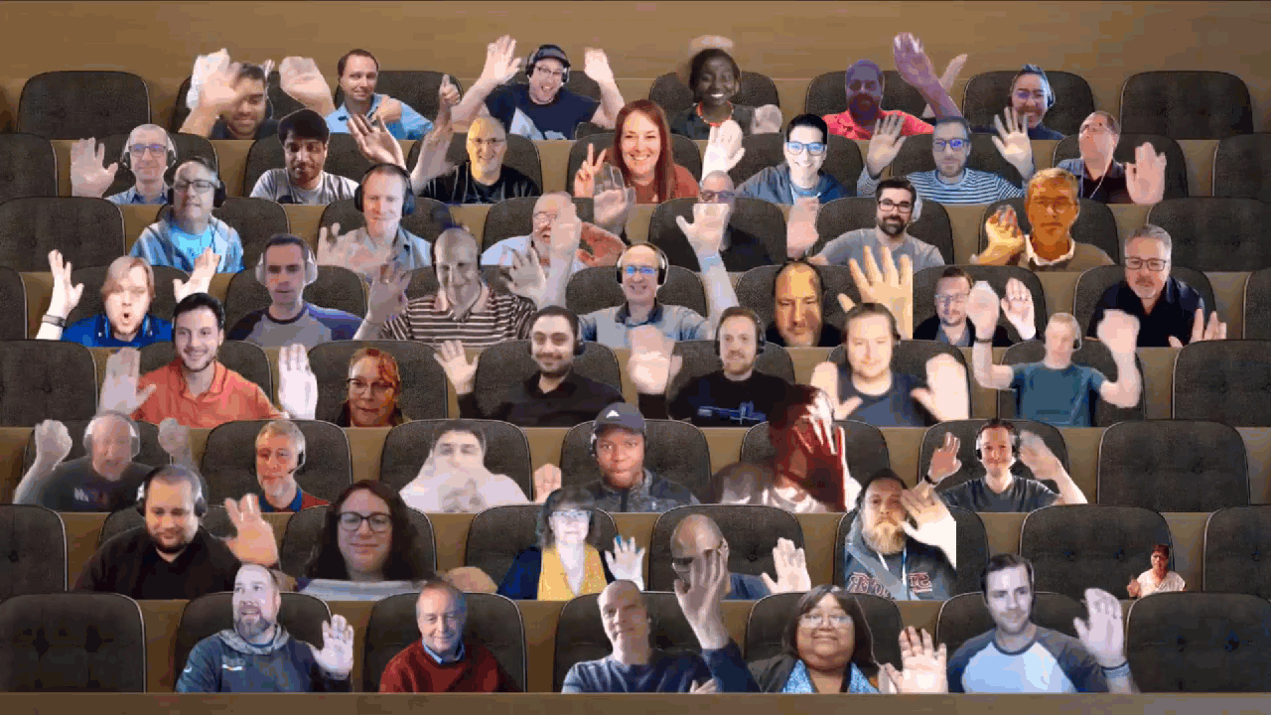

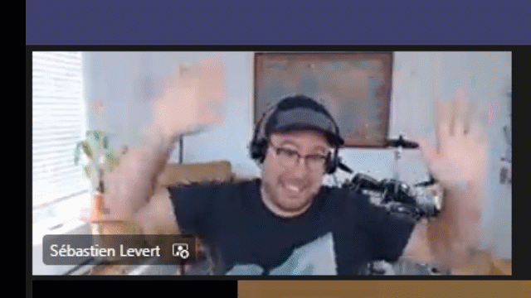
Optional picture time!
Video on and we’ll grab a Together Mode pic with those who are willing to do this.
We are together on this as a community!
Let’s all be like Seb
By enabling your camera for the picture, you grant us permission to share your picture in social media.

Slide 20

DEMO
Namrata Khubchandani - Extend your Teams Search Based Message Extension to Outlook
David Rousset - Getting started on using Azure Communication Services in your web site

Slide 21
Thank you
Recording will be available in 24 hours on
Microsoft 365 Community (PnP) YouTube channel
https://aka.ms/M365PnP/videos
(subscribe today)
Follow us on Twitter
@Microsoft365Dev | @M365PnP
Next Microsoft 365 Platform call: May 17th at 08:00 am PT
All available community calls from https://aka.ms/m365pnp

Slide 22



aka.ms/m365pnp

